Slide 1
NLP 5-6th week Progress Team IRun
20172864 서정현
20172848 정석우
20170364 한태균
Notes:
Hello, we are Team Irun, and I’m the presenter Seo Jeong Hyeon.
Let's start the presentation.

Slide 2
Index
Project Overview
Progress
Execution
Notes:
I will divide my presentation into 3 parts.
First, I will talk about our project overview.
Next, I will discuss current progress.
Lastly, We’re going to look at execution video.

Slide 3

Project Overview
Notes:
Let’s start with project overview.

Slide 4
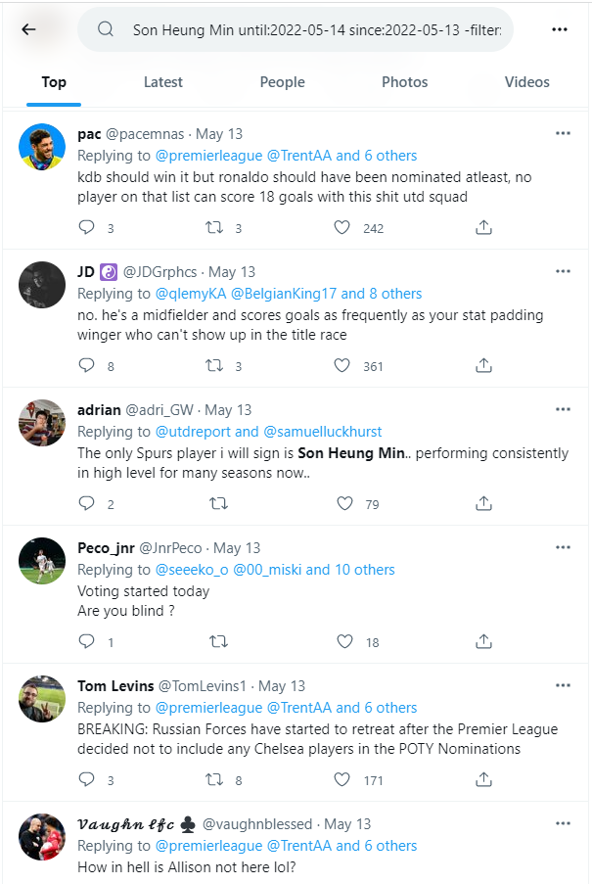
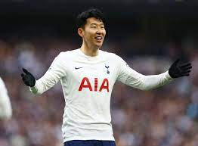
Summary
Query
User Rating: 8.5
Notes:
The goal of our project is to predict a player rating for a match through Twitter replies.

Slide 5


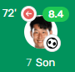
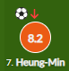
Summary
IRun
Son 8.5
new indicator !
Notes:
Player ratings are given by various sites such as whoscored, fotmob, etc.
We expect this ‘Irun rating’ could be a new football rating indicator given by non-professional users.

Slide 6




Corpus Idea
0.0~6.5
6.5-7.0
7.0~7.5
7.5~8.0
8.0-9.9
Notes:
We hypothesized that Twitter replies in a particular rating interval would have a certain tendency.
So, we received match data through an api called api-football,
and collected twitter replies through an api called tweepy,
and classified them according to a predetermined rating section.
So these classified replies become corpus.

Slide 7

Progress
Notes:
Now, Let’s move on to progress.

Slide 8
Weekly Plan
~1 weeks : Detailed Design, Set a goal
~2 weeks : Individual Crawling of Match, Rating, Tweets
~3 weeks : Sum up & Create docs, VSM
~4 weeks : Data processing, Evaluation modules
~5 weeks : Improve accuracy, modularization
~6 weeks : Process result, web test
Notes:
This is our weekly plan.
Fifth week we tried to improve accuracy by fixing stopwords and collect more data, and modularize our code.
This week we tried to process our obtained result, and test web service.

Slide 9




Data Collection
Documents | Last Week Tweets | This Week Tweets
0~6.5 | 2626 | 3299
6.5~7.0 | 3633 | 3809
7.0~7.5 | 2504 | 2671
7.5~8.0 | 2447 | 2556
8.0~ | 1433 | 1503
Total | 12643 | 13838
Notes:
Since all the popular fooball leagues are over, we have additionally collected matches of American football leagues called MLS.

Slide 10
Fix Stopwords
Add
Player name
Team name
Number
Meaningless words
player
team
time
play
left
right
etc
Remove
Meaningful words
appropriate
important/importance
interested/interesting/interest
necessary/necessarily
novel
problem
sensible
significant/significantly
successfully
etc
Notes:
We are using large stopwords to tokenize only meaningful words for player evaluation.
So we added words to stopwords that have no meaning in player evaluation such as player names, team names, numbers, or words like these.
Also, We found that the existing stopwords included important words such as "important", "necessary", and "sensible“, so we removed them.

Slide 11
Architecture
irun.py
api_football
_requester
api_football
_module.py
twitter_crawler
doc_maker.py
twitter_crawler.py
vsm
vsm.py
query_maker.py
twitter_secret.py
corpus
0.0-6.5.txt
6.5-7.0.txt
7.0-7.5.txt
7.5-8.0.txt
8.0-9.9.txt
api_football _secret.py
Notes:
We modularized our code like this.

Slide 12
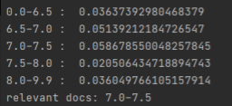
Rating Derivation Algorithm
The problem with the last result
We don't want an interval, we want a specific value !
Notes:
In general, vector space model is used for ranking, but in our project, the purpose is to determine a specific rating value using this similarity result.
So, we derive the rating value through the following algorithm.

Slide 13
Rating Derivation Algorithm
Apply min-max normalization to the result.
Apply exp(x * 𝛼) - 1 to the result.
Normalize the result by dividing by sum of result.
Calculate the rating as the dot product of result and docs weight.
Notes:
First, the result is normalized to between 0 and 1 through min-max normalization.
Next, we use an exponential function to increase the difference between large and small values. If this alpha value is larger, small similarity values are gradually ignored.
Next, the result value is divided by the sum so that the sum of the result becomes 1.
Finally, the rating is determined through the dot product of pre-determined document weights and the result. Let's see an example.

Slide 14
Rating Derivation Algorithm
result = [ 0.123, 0.126, 0.133, 0.151, 0.146 ]
0.0-6.5.txt
<5>
6.5-7.0.txt
<6.5>
7.0-7.5.txt
<7.5>
7.5-8.0.txt
<8.5>
8.0-9.9.txt
<10>
Apply min-max normalization to the result.
Apply exp(x * 𝛼) – 1 to the result. (𝛼=5)
Normalize the result by dividing by sum of result.
Calculate the rating as the dot product of result and docs_weight.
Notes:
The result is as follows. Below, that is the weight of the document.

Slide 15
Rating Derivation Algorithm
result = [ 0.123, 0.126, 0.133, 0.151, 0.146 ]
0.0-6.5.txt
<5>
6.5-7.0.txt
<6.5>
7.0-7.5.txt
<7.5>
7.5-8.0.txt
<8.5>
8.0-9.9.txt
<10>
Apply min-max normalization to the result.
Apply exp(x * 𝛼) – 1 to the result. (𝛼=5)
Normalize the result by dividing by sum of result.
Calculate the rating as the dot product of result and docs_weight.
Notes:
First, Let's normalize through the first step.

Slide 16
Rating Derivation Algorithm
result = [ 0.123, 0.126, 0.133, 0.151, 0.146 ]
0.0-6.5.txt
<5>
6.5-7.0.txt
<6.5>
7.0-7.5.txt
<7.5>
7.5-8.0.txt
<8.5>
8.0-9.9.txt
<10>
result = [0.0, 0.107, 0.357, 1.0, 0.821]
Apply exp(x * 𝛼) – 1 to the result. (𝛼=5)
Normalize the result by dividing by sum of result.
Calculate the rating as the dot product of result and docs_weight.

Slide 17
Rating Derivation Algorithm
result = [ 0.123, 0.126, 0.133, 0.151, 0.146 ]
0.0-6.5.txt
<5>
6.5-7.0.txt
<6.5>
7.0-7.5.txt
<7.5>
7.5-8.0.txt
<8.5>
8.0-9.9.txt
<10>
result = [0.0, 0.107, 0.357, 1.0, 0.821]
Apply exp(x * 𝛼) - 1 to the result. (𝛼=5)
Normalize the result by dividing by sum of result.
Calculate the rating as the dot product of result and docs_weight.
Notes:
Next, Let’s apply exponential function through the second step

Slide 18
Rating Derivation Algorithm
result = [ 0.123, 0.126, 0.133, 0.151, 0.146 ]
0.0-6.5.txt
<5>
6.5-7.0.txt
<6.5>
7.0-7.5.txt
<7.5>
7.5-8.0.txt
<8.5>
8.0-9.9.txt
<10>
result = [0.0, 0.107, 0.357, 1.0, 0.821]
result = [0.0, 0.709, 4.964, 147.413, 59.773]
Normalize the result by dividing by sum of result.
Calculate the rating as the dot product of result and docs_weight.

Slide 19
Rating Derivation Algorithm
result = [ 0.123, 0.126, 0.133, 0.151, 0.146 ]
0.0-6.5.txt
<5>
6.5-7.0.txt
<6.5>
7.0-7.5.txt
<7.5>
7.5-8.0.txt
<8.5>
8.0-9.9.txt
<10>
result = [0.0, 0.107, 0.357, 1.0, 0.821]
result = [0.0, 0.709, 4.964, 147.413, 59.773]
Normalize the result by dividing by sum of result.
Calculate the rating as the dot product of result and docs_weight.
Notes:
Next, Let’s divide by sum through the third step

Slide 20
Rating Derivation Algorithm
result = [ 0.123, 0.126, 0.133, 0.151, 0.146 ]
0.0-6.5.txt
<5>
6.5-7.0.txt
<6.5>
7.0-7.5.txt
<7.5>
7.5-8.0.txt
<8.5>
8.0-9.9.txt
<10>
result = [0.0, 0.107, 0.357, 1.0, 0.821]
result = [0.0, 0.709, 4.964, 147.413, 59.773]
result = [0.0, 0.003, 0.023, 0.693, 0.281]
Calculate the rating as the dot product of result and docs_weight.

Slide 21
Rating Derivation Algorithm
result = [ 0.123, 0.126, 0.133, 0.151, 0.146 ]
0.0-6.5.txt
<5>
6.5-7.0.txt
<6.5>
7.0-7.5.txt
<7.5>
7.5-8.0.txt
<8.5>
8.0-9.9.txt
<10>
result = [0.0, 0.107, 0.357, 1.0, 0.821]
result = [0.0, 0.709, 4.964, 147.413, 59.773]
result = [0.0, 0.003, 0.023, 0.693, 0.281]
Calculate the rating as the dot product of result and docs_weight.
Notes:
Finally, we can get a rating by multiplying the result and the document weight respectively, and summing them.

Slide 22
Rating Derivation Algorithm
result = [ 0.123, 0.126, 0.133, 0.151, 0.146 ]
0.0-6.5.txt
<5>
6.5-7.0.txt
<6.5>
7.0-7.5.txt
<7.5>
7.5-8.0.txt
<8.5>
8.0-9.9.txt
<10>
result = [0.0, 0.107, 0.357, 1.0, 0.821]
result = [0.0, 0.709, 4.964, 147.413, 59.773]
result = [0.0, 0.003, 0.023, 0.693, 0.281]
rating = 8.891
Notes:
Therefore, you can see that the rating is affected not only by the highest value, but also by other high values.

Slide 23

Web
What we have done :: get tweets about a player, made a criteria to create a rating for them -> Made simple web api to convert user-input query into ‘irun-rating’
An example of single sentence query input : “His play is amazing; his every shooting becomes a nightmare to the goalkeepers”, or “His pass is the worst. Even my 5-year-old child can pass well than him”
Notes:
To conclude, we have done with making criteria for rating calculation.
So we made a simple web api to convert user input query to our irun rating using python’s flask framework. An example of single sentence query input is like below.

Slide 24
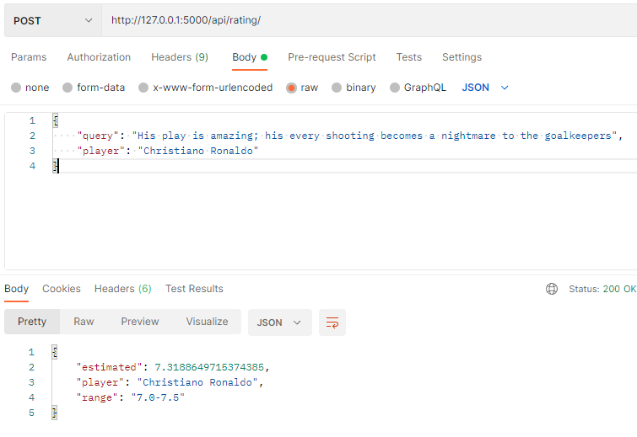
Web
Notes:
First example query is ‘his play is amazing, his every shooting become a nightmare to the goalkeeper’.
This query got 7.31 irun rating.

Slide 25
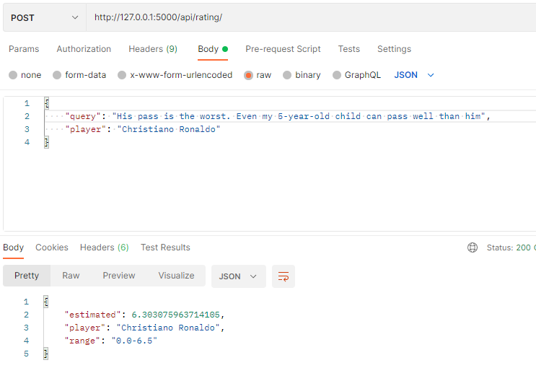
Web
Notes:
Here is another query example : ‘his pass is the worst, even my 5-years-old child can pass better than him’ and this query got 6.30 irun rating.

Slide 26

Execution
Notes:
Now, Let’s see a Execution.

Slide 27
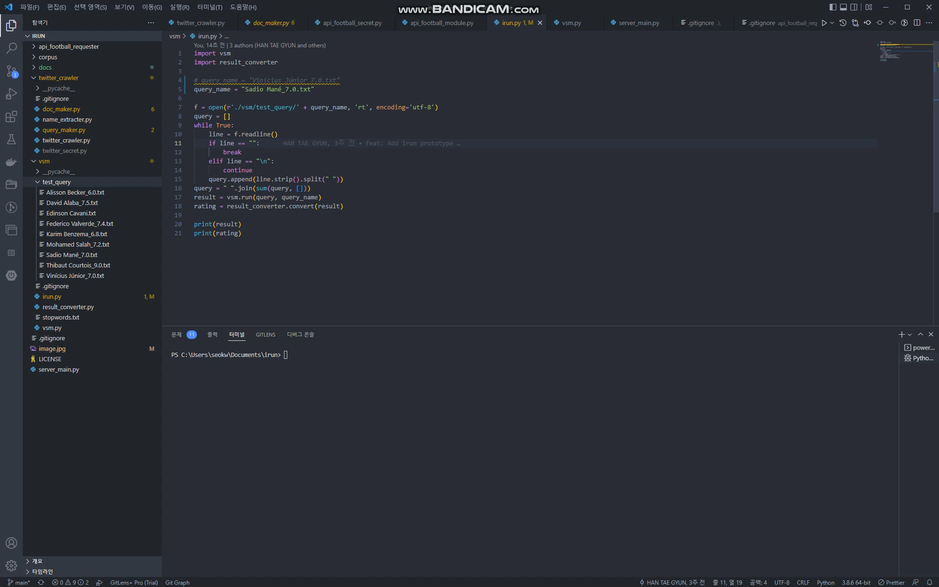
Notes:
This is a video of getting Irun Rating with a previously created query file.

Slide 28
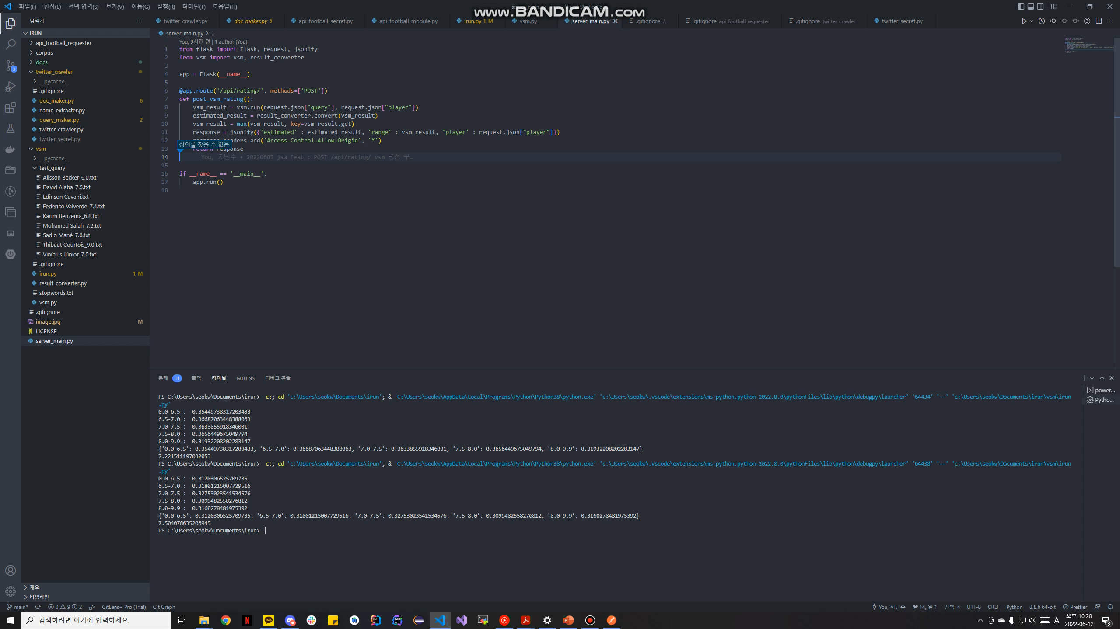
Notes:
This is a simple web api test video.

Slide 29
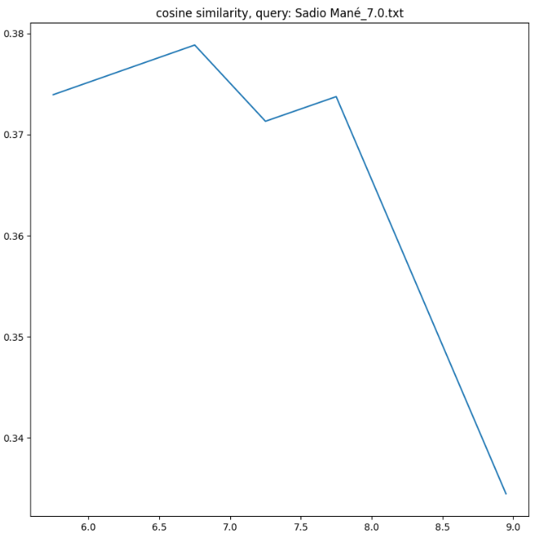
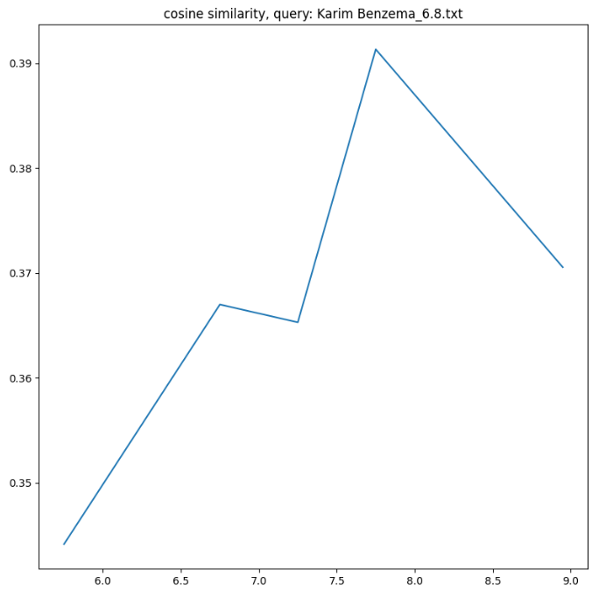
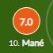
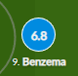
Last Week Result
Match : Liverpool(0) vs Real Madrid(1)
Champions League Final Stage
Sadio Mane
(FW)
Irun model:
[6.5 ~ 7.0]
Whoscored.com:
[7.0]
Karim Benzema
(FW)
Irun model:
[7.5 ~ 8.0]
Whoscored.com:
[6.8]

Slide 30
Player Name | Whoscored Rating | IRun Rating
Karim Benzema | 6.8 | 8.1
Sadio Mane | 7.0 | 7.0
David Alaba | 7.5 | 6.4
Federico Valverde | 7.4 | 6.8
Vinicius Junior | 7.0 | 7.6

Slide 31
Thank you
Notes:
The presentation is over. Thank you.

